Slide 1



Migrant Labor Camps
What I need to know as a Fire Inspector
Presenter:
Rick Sommerfeld
Fire Prevention Coordinator – District 1
Richard.sommerfeld@Wisconsin.gov
715-944-4114
Notes:
Hello, this is District 1 Fire Prevention Coordinator Rick Sommerfeld, and I am going to give you a brief overview of what you need to know as a fire inspector dealing with Migrant Labor Camps in Wisconsin.

Slide 2
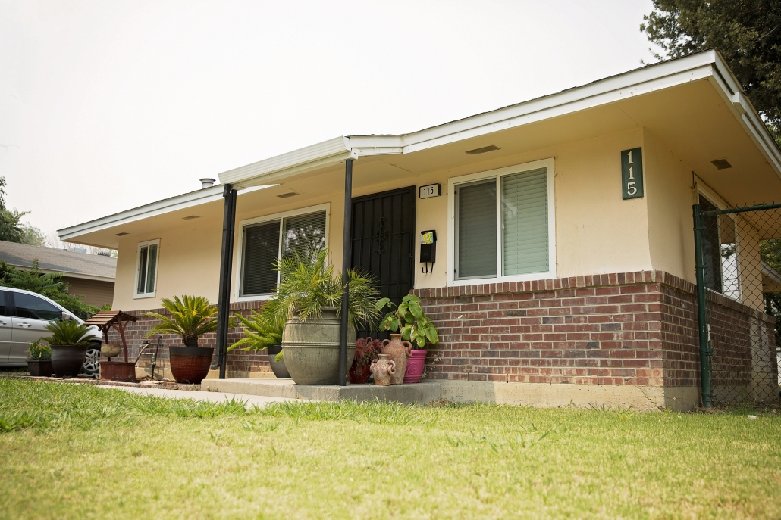
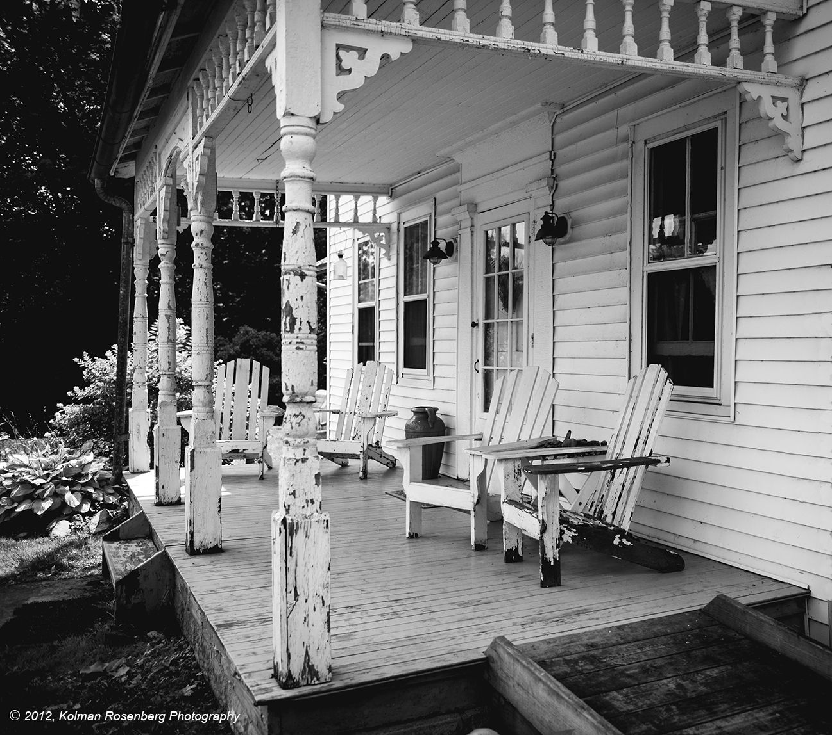
Fire Inspections and Migrant Labor Camps
The Department of Workforce Development (DWD) updated their Admin Code 301- Migrant Labor effective February 1, 2024.

Slide 3
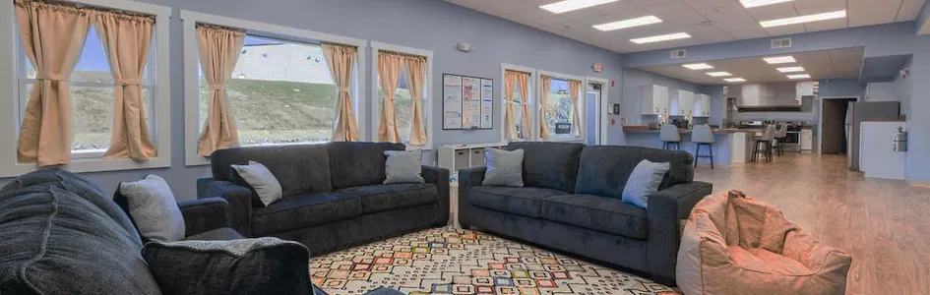
What is a Migrant Labor Camp?
According to Wis. Stat. § 103.90(3), a Migrant Labor Camp is defined as:
“The site and all structures maintained as living quarters by, for or under the control and supervision of any person for: Any migrant worker; or
Any other person who is not related by blood, marriage or adoption to his or her employer and who occasionally or habitually leaves an established place of residence to travel to another locality to accept seasonal employment in the planting, cultivating, raising, harvesting, handling, drying, packing, packaging, processing, freezing, grading or storing of any agricultural or horticultural commodity in its unmanufactured state”. This would also operations involving milk, wool, eggs and honey.
Notes:
“Migrant labor camp" does not include:
Premises occupied by the employer as a personal residence and by no more than 2 migrant workers.
Any accommodation subject to ch. 50. (Care and Service Facilities, Hospitals, Rural Medical Centers, Clinics, Hospices)

Slide 4
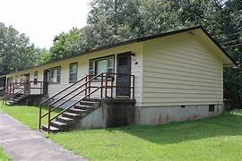
WI SS 101.01
WI SS 101.01 (12) “Public building" means any structure, including exterior parts of such building, such as a porch, exterior platform, or steps providing means of ingress or egress, used in whole or in part as a place of resort, assemblage, lodging, trade, traffic, occupancy, or use by the public or by 3 or more tenants.
Notes:
So then we look at the fire inspection side of things and here is the definition of a Public Building.

Slide 5
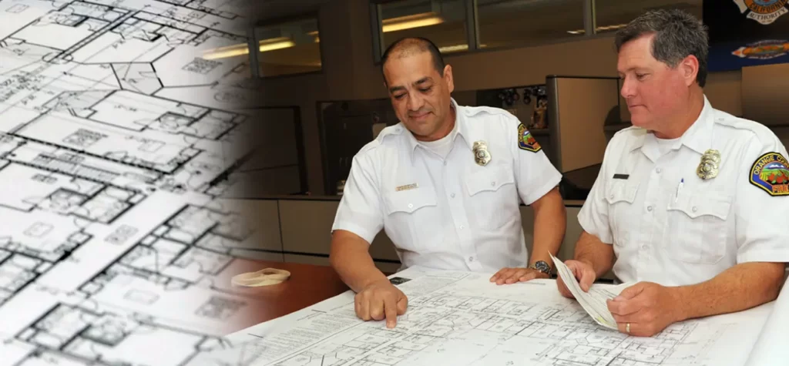
Change of Use?
Buildings may have gone through a change of use or occupancy to accommodate or become migrant labor camps.
In these change of use situations, it is important that fire department’s consult and work with their local or State building inspectors to ensure appropriate compliance.
Notes:
Was there a change of use that took place?

Slide 6
Helpful Links:
Link to DSPS letter reference fire inspections at Migrant Labor Camps-
https://dsps.wi.gov/Documents/Programs/FirePrevention/MigrantLaborCamp.pdf
Link to DWD site for Migrant Labor Camps
https://dwd.wisconsin.gov/jobservice/MSFW/migrant-labor-camps.htm
Link to DWD Fire Inspection Form DETM-19725-E
https://dwd.wisconsin.gov/dwd/forms/dws/detm-19725-e.htm

Slide 7
SPS 314 & NFPA 1
Remember to ALWAYS go by the rules in:
SPS 314
NFPA 1

Slide 8
Questions:
If more information is needed, please reach out to your District Fire Prevention Coordinator:
https://dsps.wi.gov/Documents/Programs/Maps/FireDeptSafetyHealth.pdf
OR
If you have questions specifically related to the DWD rules and updates, you may contact:
Section Chief Kathryn Mueller at: Kathryn.Mueller@dwd.wisconsin.gov or (608) 733-3907

Slide 9


