Slide 1

National Emergency Response Information System Overview
Fall 2025
Notes:
Hi my name is Sarah Brown. I am the Operation Program Associate with FP/SH and NERIS State Data Lead. I have been working closely with the NFIRS & NERIS teams in preparing for the sunset of NFIRS and the sunrise of NERIS. Just a heads-up before we begin: NERIS is an evolving platform. As fire depts use it, we will adapt to problems and update functionalities as needed.

Slide 2

Table of Contents
01
NFIRS History & What is NERIS and Why Do We Need it?
Background, Purpose, Concept
02
Key Features
Discussion on incident features and modernization examples
03
Onboarding for Local Fire Departments
What you need to know to get ready to onboard onto NERIS.
04
NFIRS Sunset
Understanding how to prepare for the NFIRS Sunset
Notes:
My presentation will include​
Read 1​
Read 2​
Read 3​
Read 4​
And finally a peak at NERIS along with a video created by Craig Weinschenk of the NERIS Team, showing you the features of NERIS.

Slide 3
NFIRS History &
What is NERIS and Why Do We Need it!
1
Notes:
Let's start off with a short history lesson about NFIRS and then we will dive into What NERIS is and Why we need it.

Slide 4
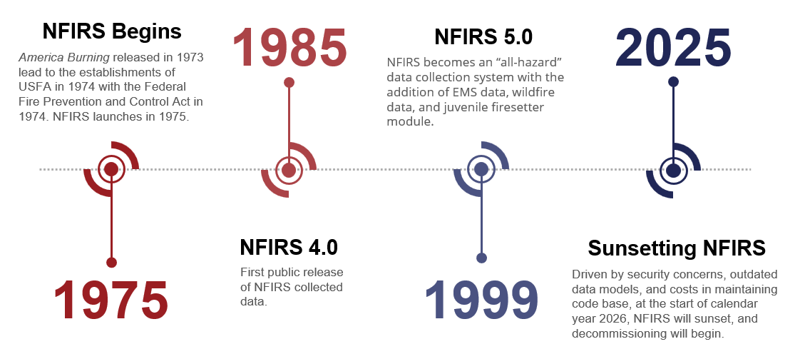
Legacy System NFIRS
Notes:
The timeline of NFIRS, starts off with the release of America Burning in 1973 which lead to the creation of the USFA and Federal Fire Prevention & Control Act in 1974. 1975 NFIRS was born.
1985 was the very first time a Public Data Release (PDR) of NFIRS collected data was done. ​
​
In 1999, NFIRS 5.0 officially became an “All-Hazard” data collection system. ​
​
I know it isn’t on the slide, but I did want to mention that between 2019 & 2020 we saw the evolution of Data Entry Tool & DEBI to the eNFIRS platform….NFIRS became completely web based and accessible from any type of internet connected device. This also eventually lead to the decommissioning of the Summary Output Reports Tool and the introduction of the Data Warehouse.​
​
And finally, 2025, was the start of the end for NFIRS. Outdated data models, costs in maintaining code base and most of all security concerns lead to decision to decommission NFIRS.​
​
​

Slide 5
Is Change Needed?
Things that HAVE changed in the fire service over the past 25 years:
  Bunker Gear & PPE
  Incident Types
  Apparatus & Equipment
  Communications
  Tactics & Strategies
  Workforce
  Training
  Technology
Things that HAVEN’T :
  NFIRS!!
YES!!!
Notes:
Ask the audience “Is Change Needed?”
(Click) Read the things that have changed.
(Click) Read the thing that hasn’t changed.
Do you think Change is Needed?? (Click) and say YES!! I think we can all agree change is needed!

Slide 6

The goal of NERIS is to empower the local fire and emergency services community by equipping them with near real-time information and analytic tools that support data informed decision-making for enhanced preparedness and response to incidents involving all hazards.
Notes:
“Read Slide”
(Click 1x) to underline the “near real-time information and analytic tools”

Slide 7
Key Features and Benefits of NERIS
2
Notes:
Let's talk about some of the Key Features and Benefits of NERIS

Slide 8
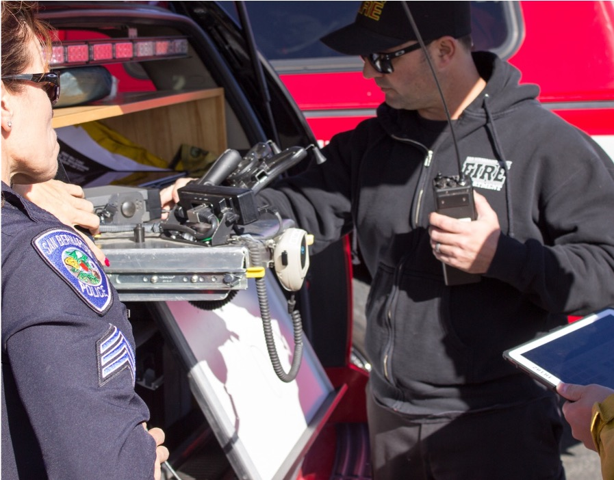
Data-Driven Leadership: A New Era for the Fire Service
Data is a living resource that captures the full complexity of the incidents we respond to and the communities we serve.
Photo: SBCFD
Notes:
We know data isn't always a firefighter's favorite subject. We're about to change that, moving into a new era of Data-Informed Leadership for the fire service. This won't just be a gold standard; it will become the norm. Data is a powerful, dynamic resource that fully captures the complexity of every incident you respond to and the communities you bravely serve.

Slide 9


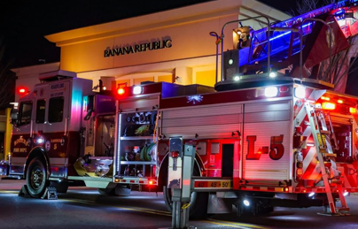
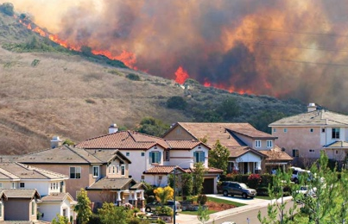
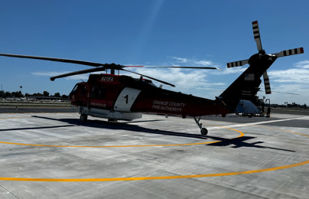
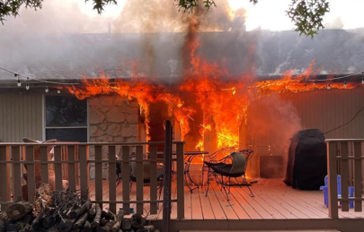
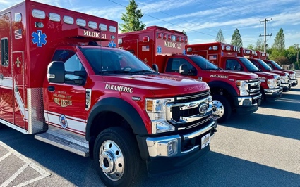
Optimizing Risk & Resource Alignment
Notes:
With this data, we can:
Identify crucial patterns.
Accelerate Solutions for emerging hazards.
And Evaluate Resource Effectiveness and Response Times using post-incident data.

Slide 10
Data Integration
People, Places, and Infrastructure
Parcel Information
Incorporate essential census-level data such as building types, ages, transportation infrastructure, and demographic details directly into incident records, enriching emergency response context.
Critical property data—including land value, improved value, year built, square footage, and acreage—for every incident location, eliminating manual entry and enhancing situational awareness.
Weather
Hazards and Current Conditions
Automated capture of weather conditions—temperature, humidity, wind, precipitation—at the time of each emergency call, streamlining data collection and freeing responders to focus on critical tasks.
Combine hazard exposure, current risk factors, and conditions to inform proactive emergency planning, targeted community risk reduction, and effective after-action analyses. Enhance efficiency by utilizing recent incident data and inter-agency resource information.
Notes:
The Data Integration currently includes:
Parcel Insights—examples of parcel Insights would be land value, improvement value, year built, square footage, and acreage—
Real-Time Weather-Instantly capture weather conditions—temperature, humidity, wind, & precipitation
People, Places & Infrastructure-this would your building types, their ages, & transportation infrastructure
Hazards & Conditions-By combining hazard and risk data with incident history and shared resources, we can better plan for emergencies, reduce community risks, and learn from what has happened.

Slide 11
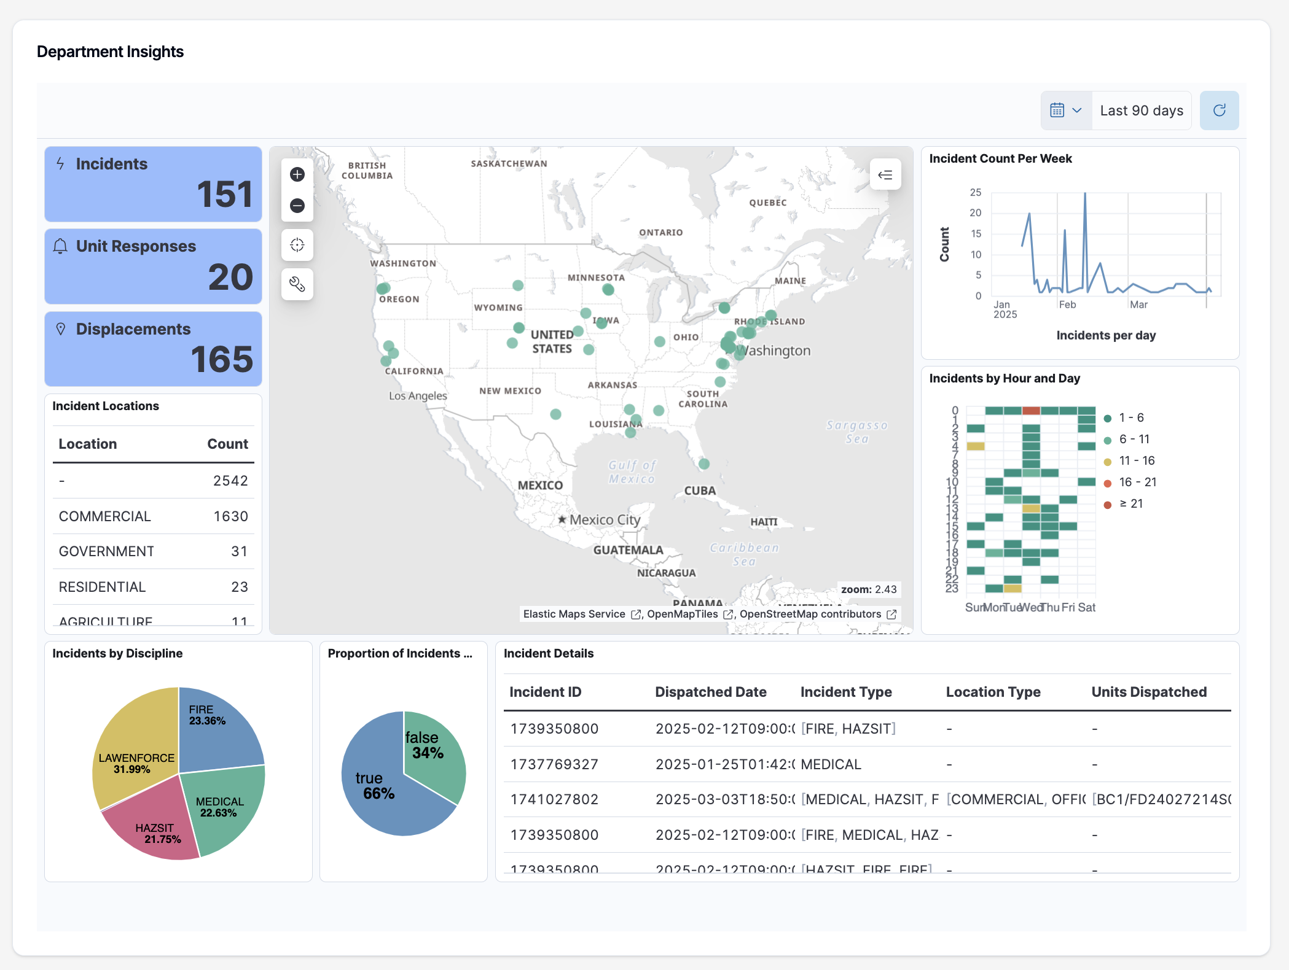
NERIS Analytics: Immediate Insights
Participating departments gain instant access to key analytics and metrics.
NERIS enhances data by integrating essential data and information for better intelligence.
The analytics menu for local fire & EMS departments will continue to expand and improve over time.
Notes:
NERIS offers free, customizable, and expanding analytic dashboards, which will enable all fire departments and decision-makers access to near real-time data on their responses and jurisdictions.

Slide 12
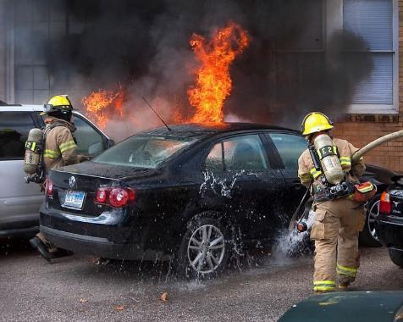
What Improvements will NERIS Offer?
Enhanced Flexibility with Multi-Hazard Incident Reporting
Comprehensive Reporting: Move from a single-category system to a model supporting up to three incident types. This reflects the complexity often faced by fire services in real-world scenarios.
For Firefighters: Simplify reporting by selecting incident types that accurately depict the scene, eliminating the guesswork of single-category constraints.
For Chiefs/Data Analysts: Reduce reliance on interpreting free-text narratives, streamlining data analysis.
NFIRS historically limited incident type selection to only one incident type,
whereas NERIS allows multiple types per incident.
Notes:
What Improvements will NERIS offer?
NERIS will offer comprehensive reporting by expanding from one to three incident type categories, it will simplify reporting for firefighters with more accurate selections, and it will streamline analysis for chiefs and data analysts by reducing the need for narrative interpretation.

Slide 13
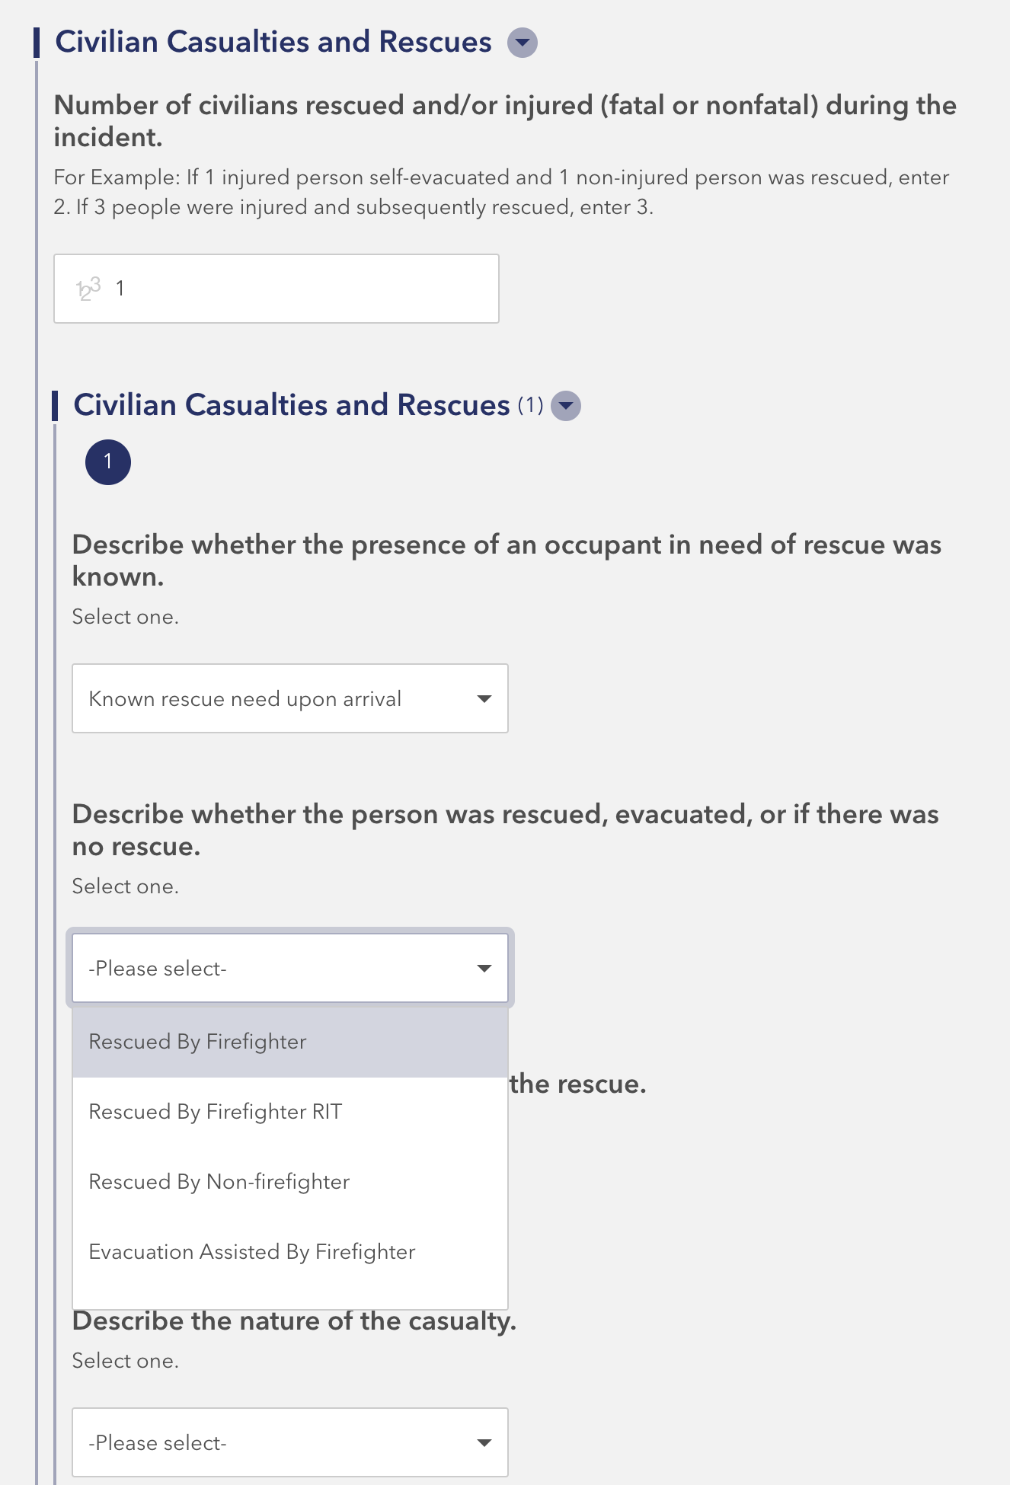
What Improvements
will NERIS Offer?
Enhanced Reporting for Actions, Tactics, Incident Outcomes, Emerging Hazards and Structure Exposures
Actions and Tactics
Metrics on Rescues, Casualties, and Maydays
Emerging Hazards
Structure Exposures
Notes:
NERIS will also offer Enhanced Reporting for a clearer picture of your incidents, this covers:
Things like-
•NERIS has modernized Actions & Tactics, this is how we’ll capture operational details like suppression techniques, ventilation, and contamination reduction.​
•Key Metrics: Will detail the tracking of rescues, casualties, and Maydays.​
•The system adapts to dynamic environments, collecting data on Emerging Hazards​
•Structure Exposures will have a streamlined entry directly into the original incident report, this will improve accuracy and reducing report time.

Slide 14
Onboarding for Local Fire Departments
3

Slide 15


NERIS Onboarding
Two Phase Process
1
2
Creating Your Account
Reporting
Fire departments can add/update attribute information after they activate their node in NERIS.
A) If using the NERIS collection app - submit when ready.
B) If using a third-party RMS – switch after your RMS is ready
Notes:
NERIS Onboarding consists of 2 Steps….Creating your Account and Reporting.
Creating your NERIS account involves adding FD information;
If you are reporting via the NERIS Collection app (direct entry) you will need to input this information directly into NERIS.
If you are using an RMS or Records Management System (Vendor software, 3rd party software etc.), much, if not all of this will transfer via API if you have it in your RMS
Regardless of the way you report, All FD admins must activate their node (account) in NERIS to start.
Reporting is what it sounds like…. You are going to utilize 1 of 2 ways to report; either NERIS Collection App (Direct Entry) or 3rd party RMS/Vendor software w/an API connection.
Now you ask what is a NERIS API? API stands for (Application Programming Interface). Simply put it’s a is a set of rules and tools that allows different software applications to communicate with each other.
Why is NERIS API Integration.. this so important?
Allows connection between your RMS &/or CAD into NERIS… Without it your incident won’t get into NERIS.
This will also set the stage for future integrations from NERIS to other systems, like CRR..
Eliminates the Bulk import
Most importantly, NERIS has established strict guidelines for our RMS vendors on how data is input, which means no more invalid entries!

Slide 16

Vendor Readiness
The NERIS-compatible badge signifies that a vendor’s software
is capable of data exchange with the NERIS platform.
To earn a NERIS compatibility badge, a vendor must:
Create an integration between their software and NERIS
Submit a new incident in the test environment to the FSRI Fire Department
Capture the unique incident number and submit an update to the incident that was created
Establish a station and add a unit to the FSRI Fire Department
Notes:
If you decide to or are continuing to use an RMS…look for the "NERIS Badge." All RMS vendors must have this badge to connect with NERIS API. Vendors earn this badge only after completing four specific requirements.
1. Create an integration
2. Submit a new incident in the NERIS test environment
3. Capture a unique incident #. They must also submit and update to an existing incident in NERIS Test environment.
4. Establish a station with a unit (apparatus) to their test environment FD.

Slide 17
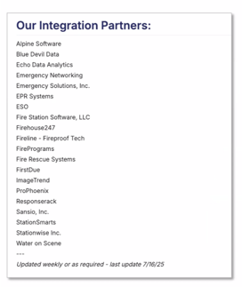
Vendor Integrations by the #’s
20 Badged Vendors
8 Unique Vendors Sending Data in production
2 more testing with Depts in NERIS sandbox
28 Vendors in progress + 3 depts building their own solutions
Latest list of Vendor Integration Partners
https://neris.fsri.org/integration-partners
Notes:
Vendor Integrations:
For the most current list of approved NERIS vendors, visit the "Integration Partners" section of the neris.fsri.org website. I have the direct link on the slide. Please note, the vendor list I used for the PowerPoint is outdated. NERIS updates this list frequently, so if you don't see your vendor, check back or contact the NERIS helpdesk or you can contact your vendor for a status update on their badge.

Slide 18
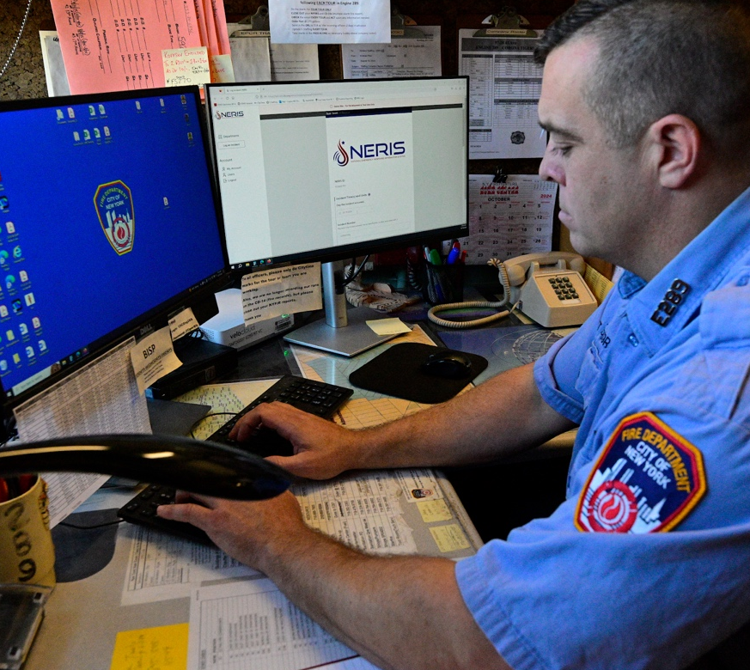
NERIS Onboarding
Checklist
Department demographics
GIS boundaries of district and any other region sets
Station names and addresses
Unit and apparatus inventory
  CAD designations, unit types, and unit level staffing
Department services provided
  Fire, EMS, investigative, CRR, etc.
Department relationship information
  Mutual/automatic/contract agreements
Photo: NYFD
Notes:
NERIS Onboarding Checklist
Getting ready for NERIS onboarding is pretty straightforward, you’re likely to have most of this information at your fingertips.
But here's a quick overview of what you'll need:
Department Demographics
GIS boundaries- for your jurisdiction
Station names and addresses- if you have multiple
Unit and Apparatus Inventory
CAD designations, unit types, and staffing levels
Department Services provided (e.g., Fire, EMS, Investigations)
Department Relationship Information (e.g., mutual &/or automatic aid agreements)

Slide 19




NERIS Ready: 2025
Project
Manager
Establish a primary person of contact
Department
Details & GIS
Obtain boundary and response area GIS layers
Detailed information you’ll need includes unit information, station addresses, minimum staffing and department attributes like ISO rating, accreditation status, etc.
Training, Orientation,
& Awareness
Begin to push training materials about NERIS and the importance of data inputs to your members
Share information about NERIS with neighboring agencies
Notes:
What do you need to do to get NERIS Ready…
1^{st-} Please designate a primary project manager/point of contact and a backup. Typically, the Chief serves as the primary, with the NFIRS person as the backup. This ensures continued correspondence, especially during absences or transitions.
2nd- We need your maps (GIS layers) showing your boundaries and where you respond. Also, include details like what units you have, all your station addresses if you have more than one, how many people you need on duty, and your ISO rating.
And lastly- Get the word out about NERIS training! There are great videos available (I'll show you them soon) that are the perfect place to start. And remember to share with your neighbors. Set up group trainings. Another great idea is to make sure the NERIS contacts from other fire depts have your NERIS Contact phone numbers for quick questions.
You can always call me, your fire coordinator, or the NERIS Help Desk anytime; we're here and happy to help.

Slide 20
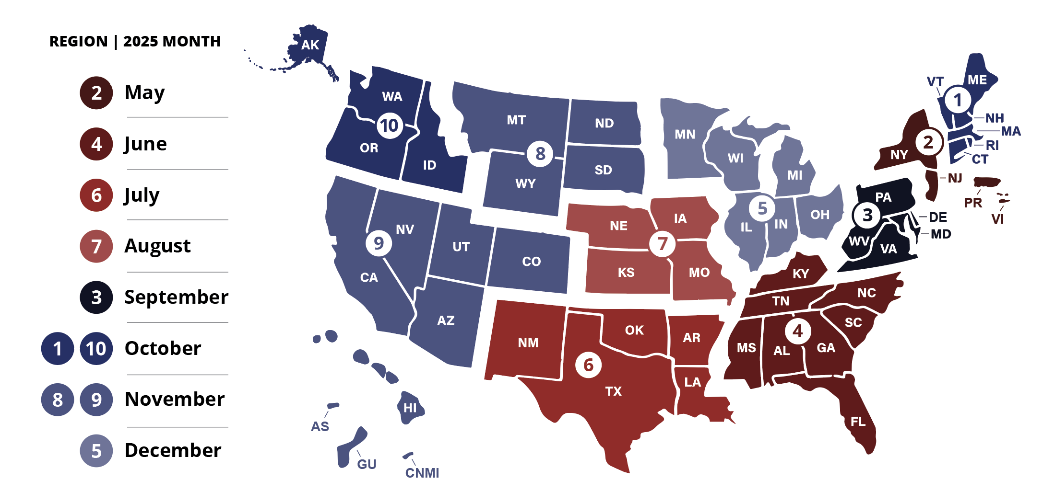
2025
Onboarding Schedule
2,385
5,009
3,632
2,400
3,080
2,496
2,701
5,460
Notes:
Regions 2,4, 6 & have been successfully onboarded…. FEMA Region 3 will start in Sept.
(Click) Wisconsin is in Region 5 and we’re scheduled for December….but IF you would like to onboard early reach out to me via email and I will send you the link to get started. Just because you onboard step 1 doesn’t mean you have to start reporting right away you can start as soon as you are ready or when your RMS is ready or you can wait until December when Wisconsin onboards or until January when it becomes mandatory.

Slide 21
NFIRS Sunset
4

Slide 22
NFIRS Sunset Basics
NFIRS
  Planned for sunset and decommissioning in early 2026.
NFIRS Public Data Release (PDR) on OpenFEMA
  Cleaned and processed annual, national data set made publicly available.
  Not full, raw data.
  Data currently available for 1980-2023.
  Geospatial NFIRS PDR data also available for 2014-2023.
  Data for 2024 and 2025 will be packaged and released on OpenFEMA.
  Link: https://www.fema.gov/about/openfema/data-sets/fema-usfa-nfirs-annual-data
NERIS will not consume or connect with historical NFIRS data
More Information: https://www.usfa.fema.gov/nfirs/about/sunset/index.html
Notes:
NFIRS closed its doors on Jan 31, 2026. All access to NFIRS is entirely gone. If you had a Records Management System (RMS) you should have access to any historical data that you entered into that system.
All 2025 NFIRS data must have been valid and ready for release by January 31st's close of business to be included in the Public Data Release (PDR). I released incidents throughout the month of January, with my final submission on the 31st. Any Invalid or missing data was not released.
As a reminder:
NFIRS and NERIS data will not co-mingle…

Slide 23
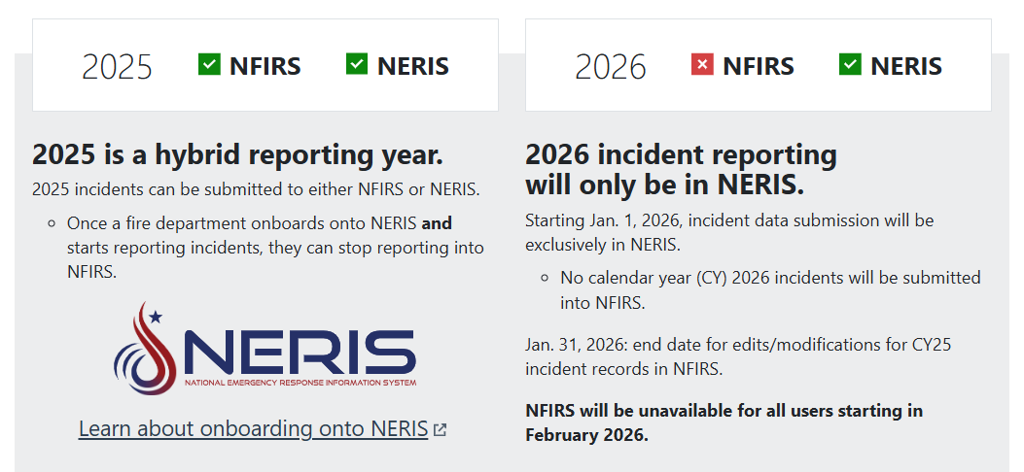
NFIRS Sunset Essentials
Notes:
2025 will be a hybrid (and potentially messy) reporting year. It was crucial to stop reporting to NFIRS once you began with NERIS.
All FDs shifted to NERIS on January 1, 2026, if you have not started onboarding or reporting to NERIS please reach out to me directly.

Slide 24
NFIRS Data Ownership
Entities contributing data to NFIRS retain ownership of their data.
NFIRS is not authorized to serve as an entity’s system of record in fulfilling their local jurisdiction’s records retention or storage solution.
“The data collected and input into NFIRS by the local fire departments and states belongs the specific users; FEMA/USFA does not have access to this information other than those staff who maintain the system. Therefore, historical data including PII are kept indefinitely for use in longitudinal analyses by those fire departments that own the data.”
Privacy Impact Assessment for the National Fire Incident Reporting System (NFIRS)DHS/FEMA/PIA-044
Notes:
Entities contributing data to NFIRS remain the sole owners of their information. It's important to note that NFIRS is not/was not designed to be a system of record for fulfilling local jurisdiction's data retention or storage requirements.

Slide 25
Communication is Key!
NERIS Contacts:
NERIS.Helpdesk@UL.ORG- Help Desk (Technical Issues)
-Hours for the Help Desk are 7 days a week- 7am-7pm
Sarah2.brown@wisconsin.gov
- Sarah Brown DSPS Fire Prevention/Safety & Health
Notes:
On the screen are the contact lists for NERIS if you have question or concerns please reach out.

Slide 26
Important Resources
NERIS URL- https://neris.fsri.org/
Sign in
About NERIS
  Onboarding, FAQs & Integration Partners
Resources
  Resource Hub, Technical & User References, Videos & Data Dictionary
Updates
  SIREN! NERIS Blog
Connect
  Upcoming Events
  Contact Us
Support
  Help Desk
Notes:
Important Resources you’ll need ….Starting off with the URL that will do it all https://neris.fsri.org/

Slide 27

Thank you.
Notes:
1. Stop Sharing in Teams
2. Share button in Teams
3. Click on Include Sound
4. Click on Window, choose the window with the NERIS website
5. Show the tabs About NERIS, Resources, Updates, Connect and Support (use Notes on the Word Document)
6. Go back to the Resource tab.
7. Click on Video and then Click on the video: NERIS in Action: Platform Demo
Craig’s video at https://vimeo.com/nerisdata

